Slide 1
Autoencoder

Slide 2
Contents
1. Compare the difference between PCA and a single layer AE
2. Compare the difference between PCA and a Convolutional AE
3. Explore the usages of AE

Slide 3
1. PCA vs. a single layer AE
Landsat8 images
Scene 142_49 (India)
Date: 01/20/2017
7 bands
Firstly we used pca to reduce the dimensionality of the data:
3 components were extracted from 7 bands.
Then we used autoencoder to compress images again:
We got 3 encoded images.

Slide 4
The Structure of a single layer Autoencoder
class autoencoder(nn.Module):
def __init__(self):
super(autoencoder, self).__init__()
self.encoder = nn.Sequential(
nn.Linear(7, 3),
nn.ReLU(True)
)
self.decoder = nn.Sequential(
nn.Linear(3, 7),
nn.ReLU(True)
#nn.Sigmoid()
)
def forward(self, x):
x = self.encoder(x)
x = self.decoder(x)
return x
3 encoded bands
Implementation in Pytorch
7 raw bands
7 decoded bands

Slide 5
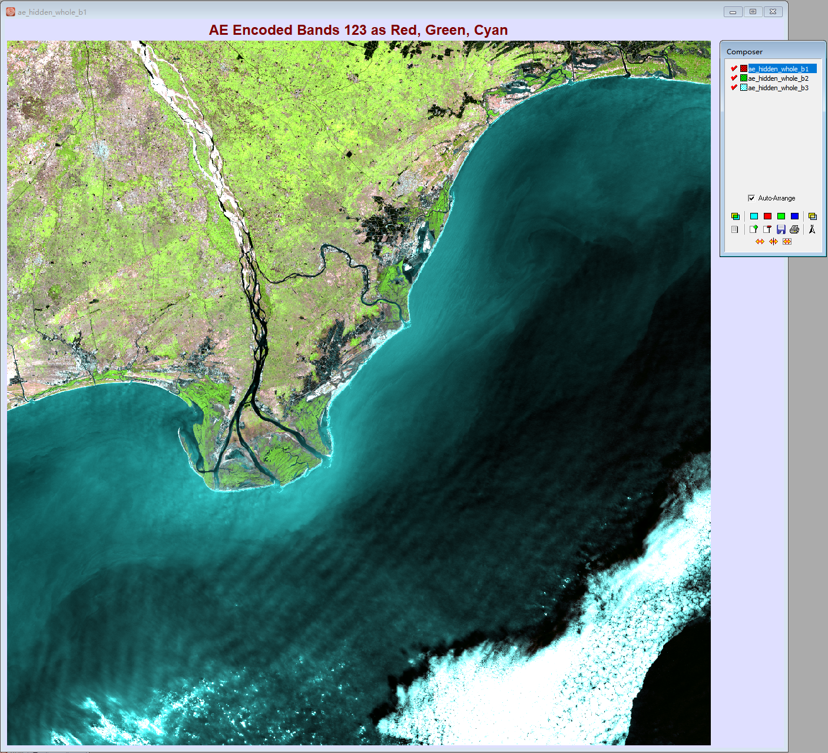
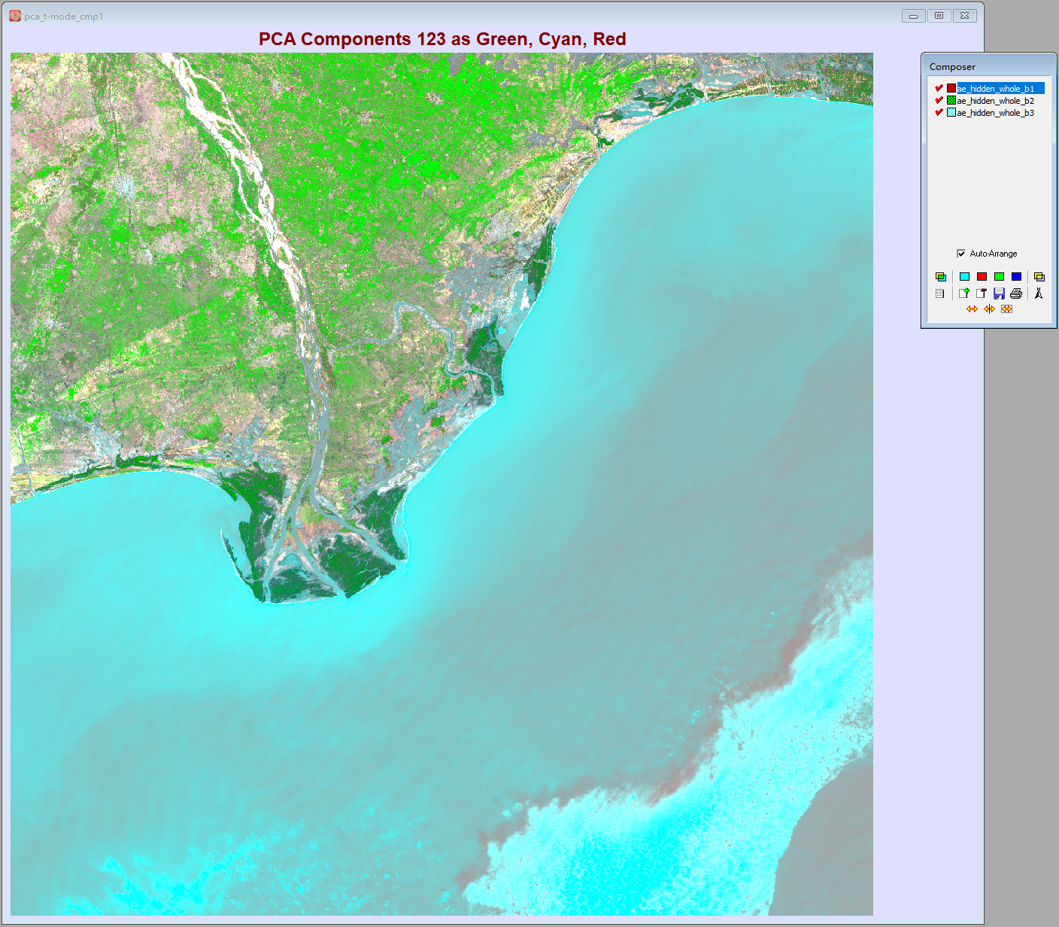
Encoded images VS. Components

Slide 6
Linear regression between PCA components and encoded bands of AE:
Seem that Component 3 is not highly correlated with anyone of the encoded bands.
What if we use multivariate linear regression with Cmp3 as dependent variable and encoded bands as independent variables?
--99.9572% of the variance (R2) in Cmp3 can be explained by three encoded bands
--Cmp2 : 99.9818%; Cmp1: 99.9977%

Slide 7
Linear regression between PCA components and 7 raw bands
Linear regression between encoded bands and 7 raw bands

Slide 8
Differences between the reconstructed bands of AE and PCA all using (reconstructed) bands 4, 6, 5 as B, G, R
Raw Bands 465
AE Decoded Bands 465
PCA Inversed Bands 465
Seem that PCA and AE both can reconstruct them pretty well, but which one did a better job?

Slide 9
MSE of the reconstructed bands
Each value is the Mean Squared Error between the raw band and the corresponding reconstructed band
For example:
4 | 1
3 | 2
4.12 | 1.03
3.04 | 2.1
Raw
Reconstructed
In this case, MSE = 0.12²+0.03²+0.04²+0.1²=0.0269
Thus, AE did better for band 1, 2, 3, 5, 6, and 7; PCA did better for band 4.
AE did a better job overall.

Slide 10
2. PCA vs. Convolutional AE

Slide 11
Instead of using each pixel of the same location in 7 bands as input, convolutional autoencoder can directly use the 7 whole bands as input, so the input size is 1*7*4000*4000 (1 represents the batch size), and this input size in a single layer autoencoder is batch_size*7.
Can we use 7 whole bands as input in a single layer autoencoder?
No, because it would require over 1TB graphic card memory; in convolutional autoencoder, it only requires about 3.6 GB graphic card memory.
The structure of convolutional autoencoder is:
1*7*4000*4000 →1*16*333*333 →1*7*4000*4000
class autoencoder(nn.Module):
def __init__(self):
super(autoencoder, self).__init__()
self.encoder = nn.Sequential(
nn.Conv2d(7,32,3,stride=3,padding=1),
nn.ReLU(True),
nn.MaxPool2d(2,stride=2),
nn.Conv2d(32,16,3,stride=2,padding=1),
nn.ReLU(True),
nn.MaxPool2d(2,stride=1)
)
self.decoder = nn.Sequential(
nn.ConvTranspose2d(16,32,3,stride=2),
nn.ReLU(True),
nn.ConvTranspose2d(32,16,5,stride=3,padding=1),
nn.ReLU(True),
nn.ConvTranspose2d(16,7,2,stride=2,padding=1),
nn.Tanh()
)
def forward(self, x):
x = self.encoder(x)
x = self.decoder(x)
return x
encode
decode

Slide 12
Encoded images
MSE

Slide 13
3. Other interesting applications of AE

Slide 14
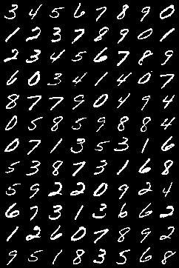
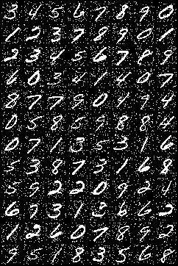
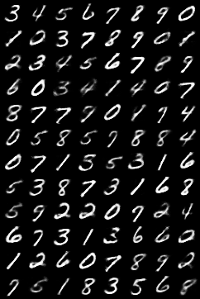
Remove noise
autoencoder
Raw image
Noise added
Denoised image

Slide 15
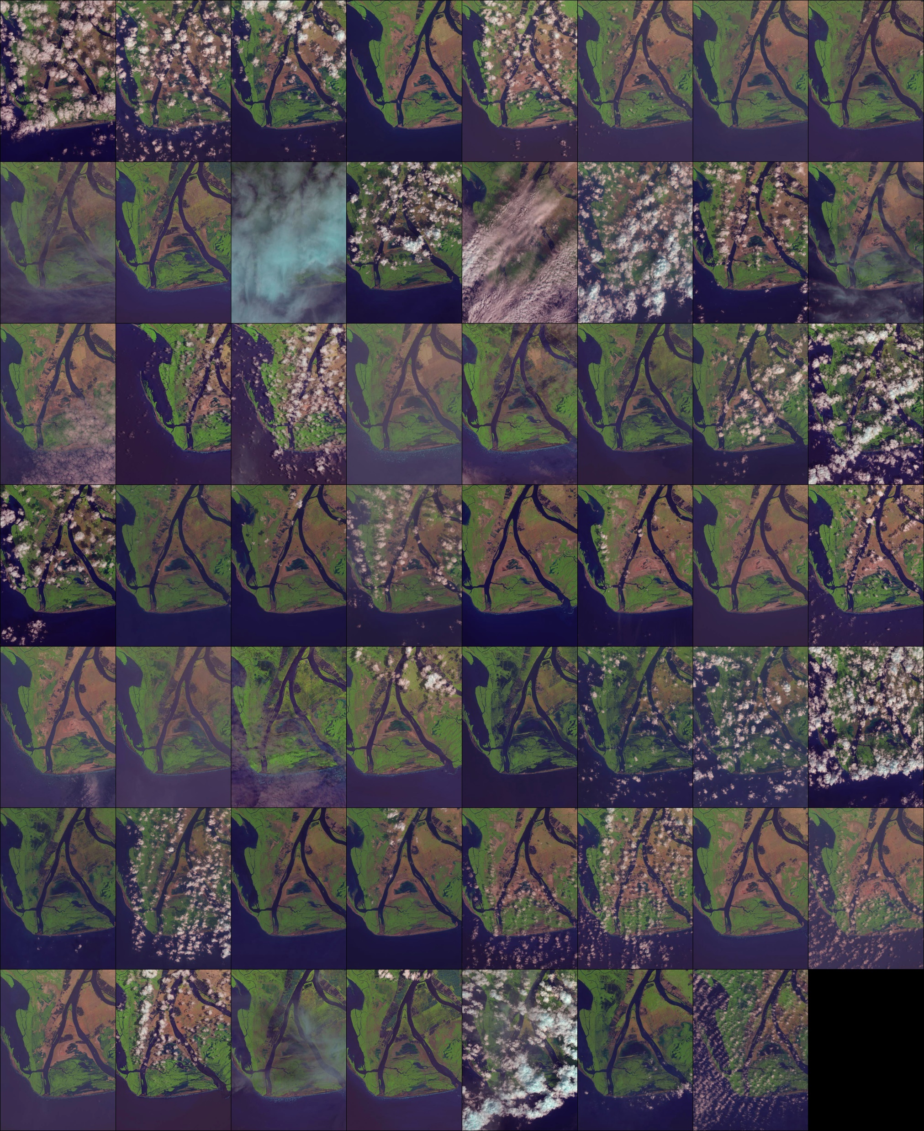
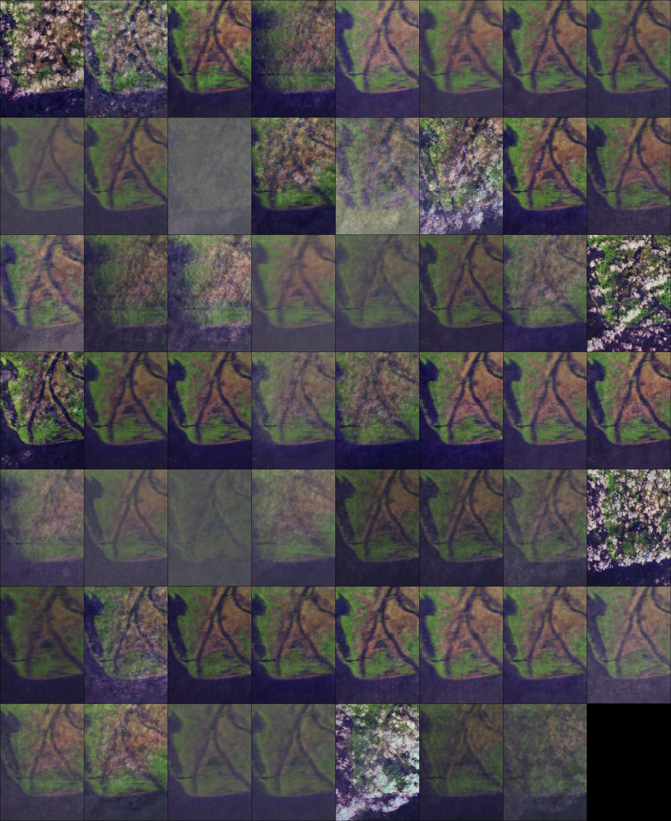
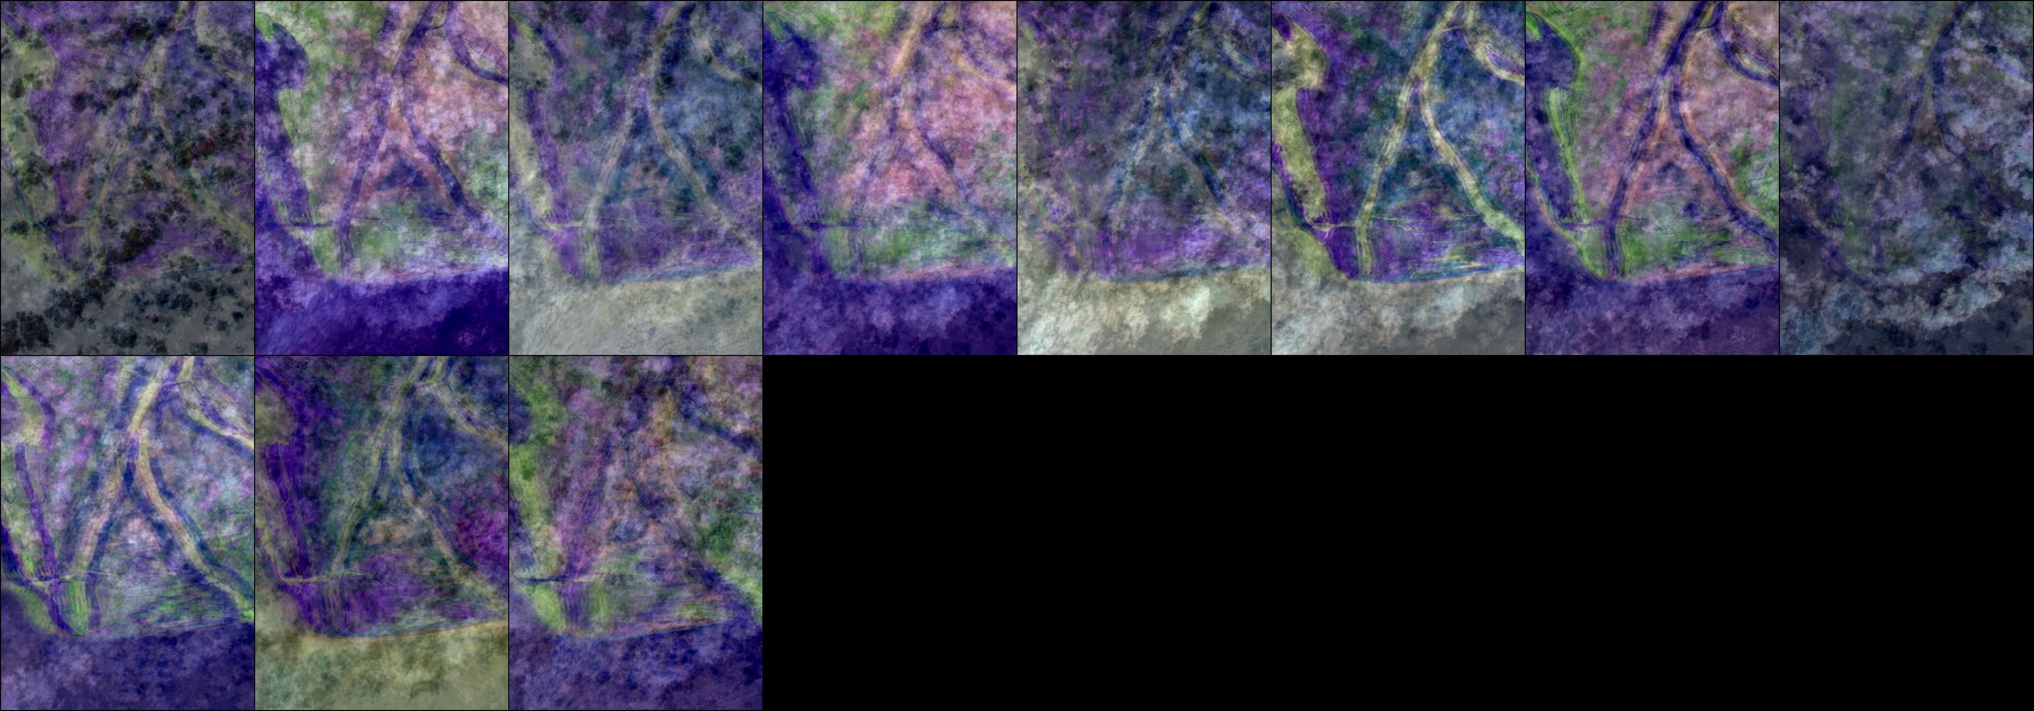
Can AE remove clouds?
Encoded image
Raw image
Decoded image

Slide 16
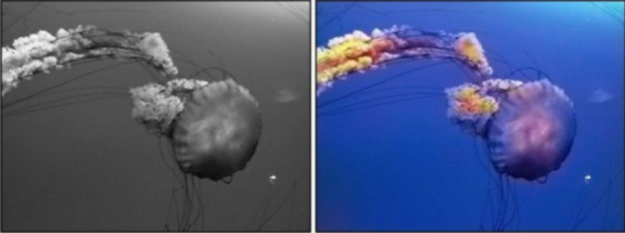
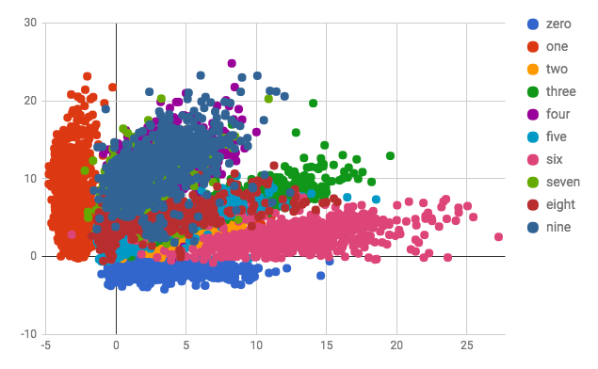
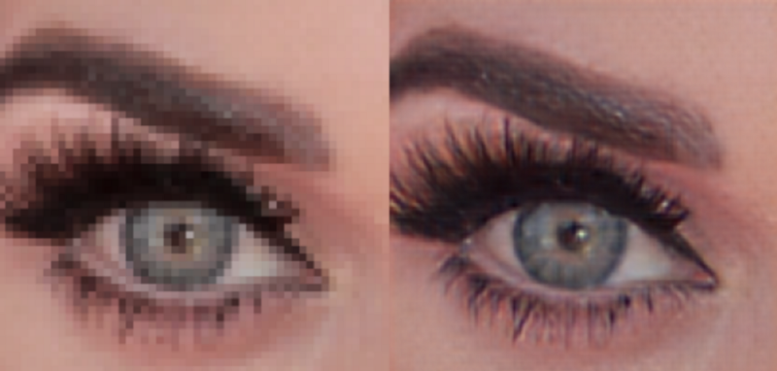
Advanced applications (CAE)
— fully image colorization
— latent space clustering
— generating higher resolution images

Slide 17
Other Applications
1.Image search
— — An image can be compressed into around 30-number vectors (as in Google image search).
2.Topic Modelling & Information Retrieval (IR)
Great usage of autoencoder for our project: Data preprocessing

Slide 18
References :-
http://ufldl.stanford.edu/tutorial/unsupervised/Autoencoders/
https://hackernoon.com/autoencoders-deep-learning-bits-1-11731e200694
https://deeplearning4j.org/deepautoencoder
https://lazyprogrammer.me/a-tutorial-on-autoencoders/

